Slide 1


Welcome to Olomouc
GiBS 2020

Slide 2
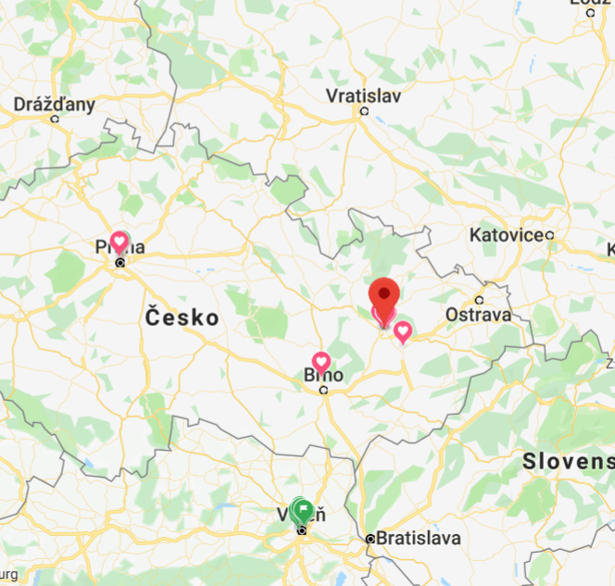
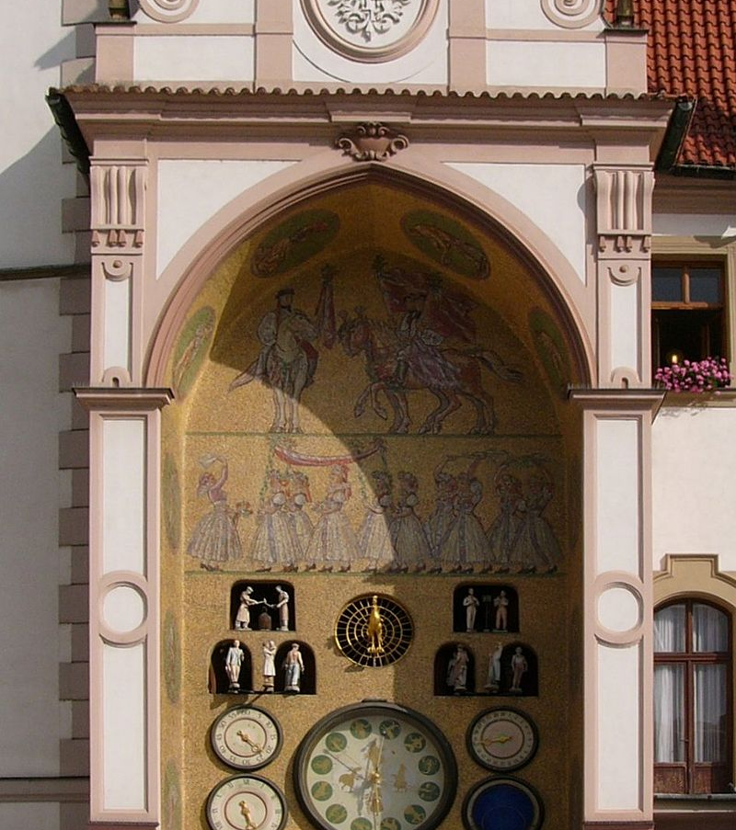
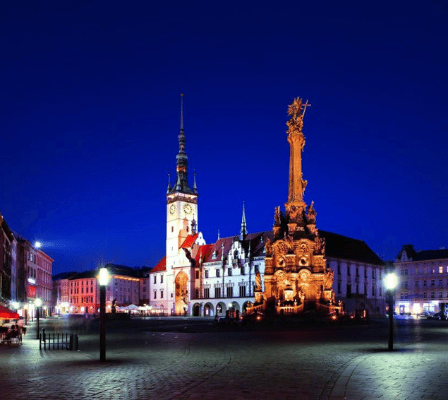
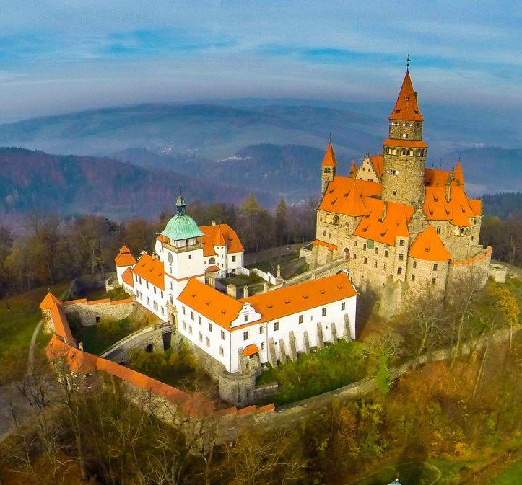
Why Olomouc
The heart of Czech Republic, the heart of Europe!
The real Czech Republic beyond Prague!
(But also called little Prague, so there’s that)

Slide 3
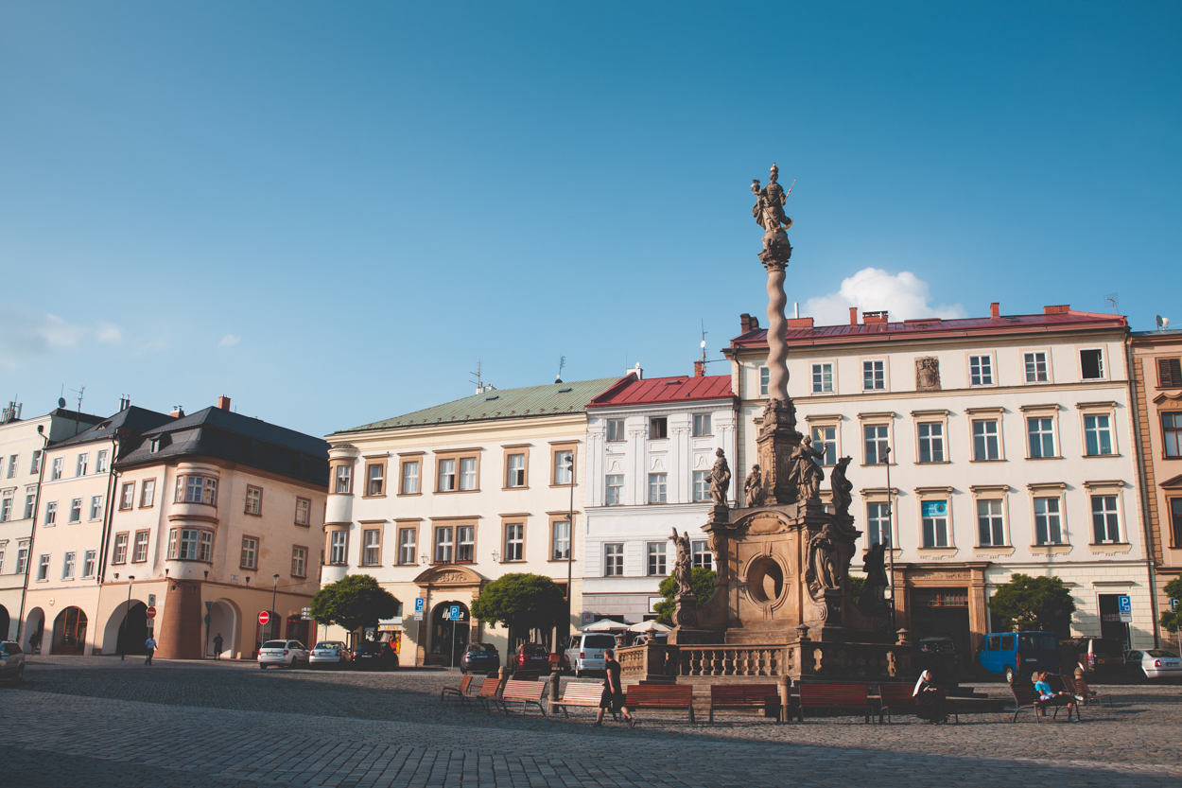
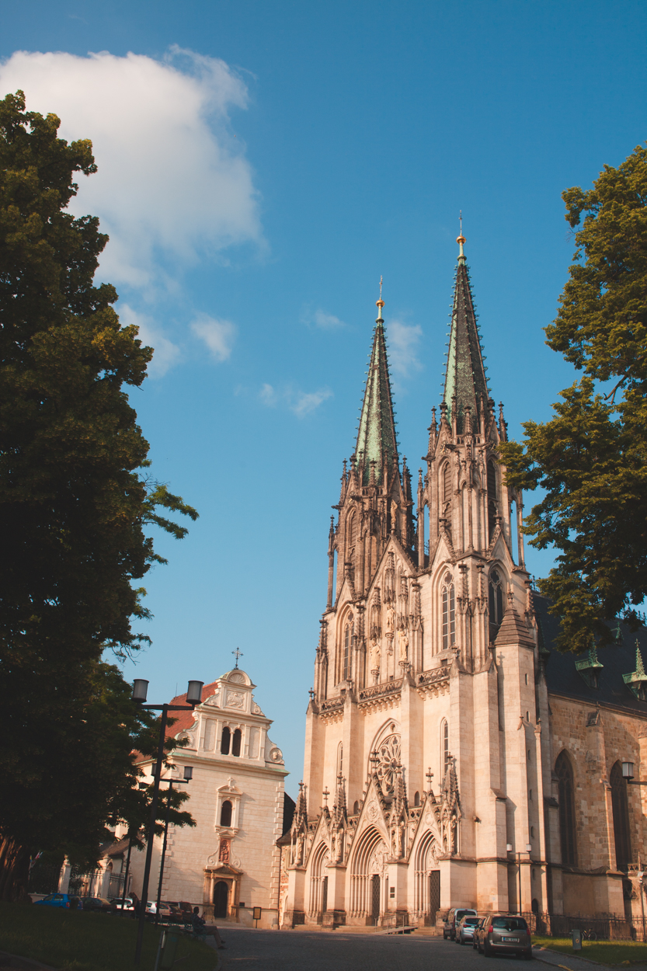
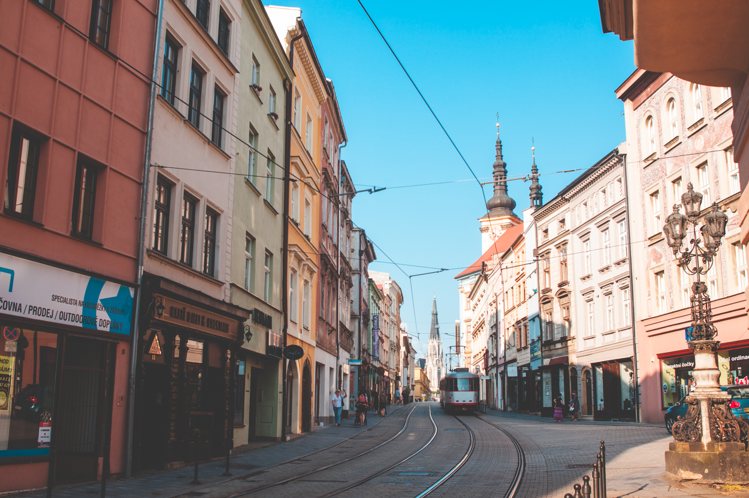
Architecture, history, infrastructure, future

Slide 4
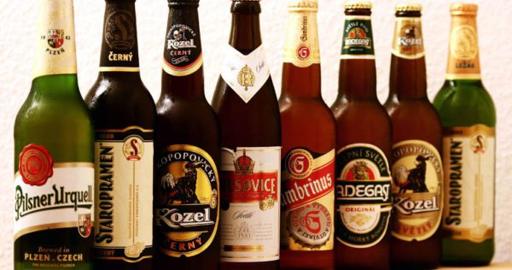
And of course…

Slide 5
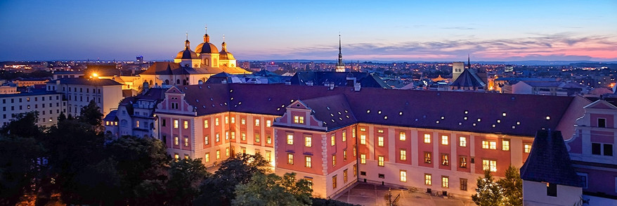
Why Palacky Uni?

Slide 6
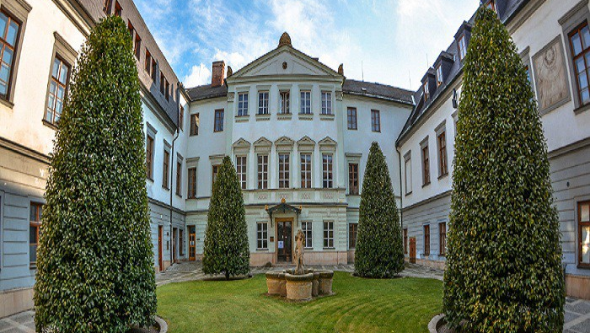
Crossroads
We want to bring out the formal and the quantitative with the complex subjectivity of biosemiotics together.

Slide 7
How to get there
Actually easy!
Close to a number of important airports: Prague (2:30 hours by train), Vienna (3 hours by bus), Bratislava, Krakow, Wroclaw

Slide 8
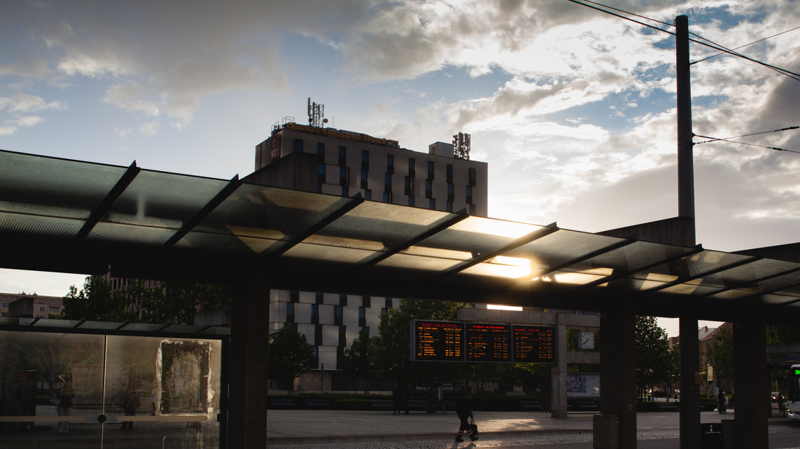
We hope to see you there next year!

